Slide 1
Process and Threads
Contents: Process and Thread, Types of Threads, Thread programming

Slide 2
Revision
Process and Threads
Thread Life Cycle

Slide 3
Process and Threads
  A process is an instance of a running (or suspended) program.
  Threads are analogous to a “light-weight” process.
  In a shared memory program a single process may have multiple threads of control.
  Threads are created within a process

Slide 4
Process vs. Threads
  process:
    an address space with 1 or more threads executing within that address space, and the required system resources for those threads
    a program that is running
  thread:
    a sequence of control within a process
    shares the resources in that process

Slide 5
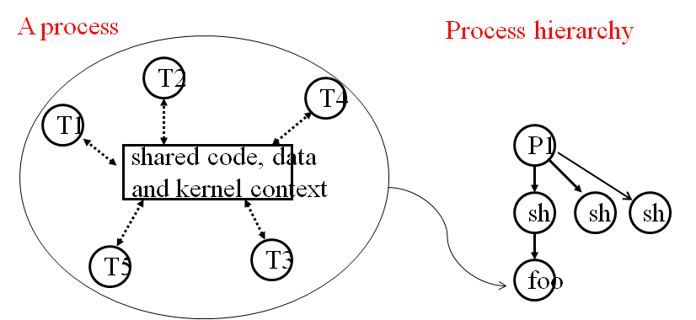
Logical view of Threads

Slide 6
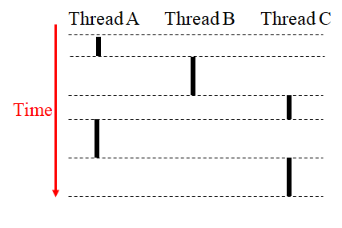
Concurrent Thread Execution
  Two threads run concurrently if their logical flows overlap in time Otherwise, they are sequential
  Concurrent:
    A & B, A&C
  Sequential:
    B & C

Slide 7
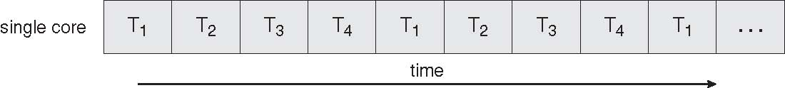
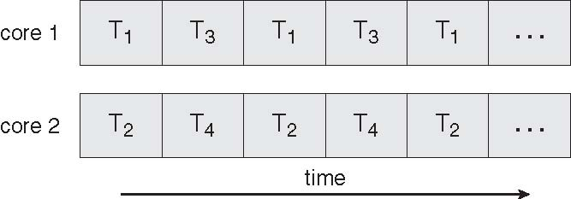
Execution flow on one-core and multi-core
  Concurrent execution on a single core system
  Parallel execution on a multi-core system

Slide 8
Benefits of Thread
  Responsiveness
  Resource Sharing
  Economy
  Utilization of MP Architectures

Slide 9
Thread Programming with Shared memory
  Program is a collection of threads of control.
  Can be created dynamically
  Each thread has a set of private variables, e.g., local stack variables
  Also a set of shared variables, e.g., static variables, shared common blocks, or global heap.
  Threads communicate implicitly by writing and reading shared variables.
  Threads coordinate by synchronizing on shared variables

Slide 10
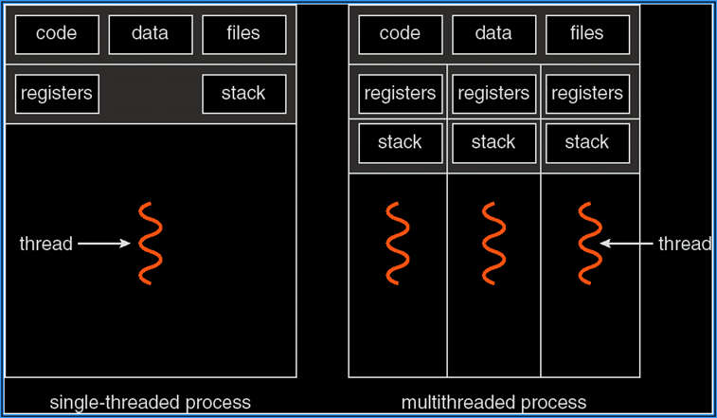
Single and Multithreaded Process

Slide 11
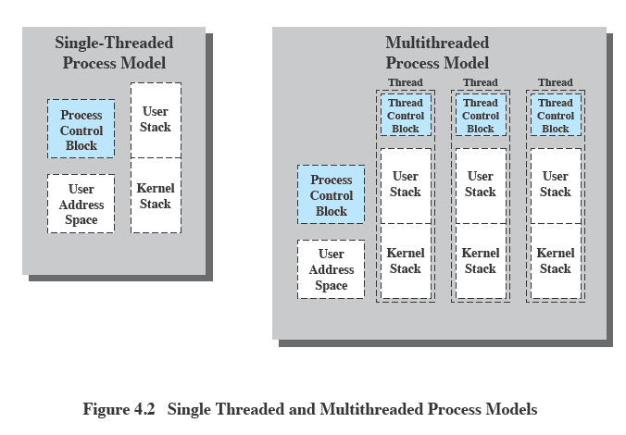
Threads vs. Processes

Slide 12
Benefits of Threads
Takes less time to create a new thread than a process
Less time to terminate a thread than a process
Switching between two threads takes less time that switching processes
Threads can communicate with each other without invoking the kernel

Slide 13
Threads
Several actions that affect all of the threads in a process
  The OS must manage these at the process level.
Examples:
  Suspending a process involves suspending all threads of the process
  Termination of a process, terminates all threads within the process

Slide 14
Linux Threads
Linux refers to them as tasks rather than threads
Thread creation is done through clone() system call
clone() allows a child task to share the address space of the parent task (process)

Slide 15
Creating Threads
  Posix 1003.1c defines a thread interface
    pthreads - defines how threads should be created, managed, and destroyed
  Unix provides a pthreads library
    API to create and manage threads
    you don’t need to worry about the implementation details

Slide 16
Creating Threads
  int pthread_create(pthread_t *tid, const pthread_attr_t *tattr, void*(*start_routine)(void *), void *arg);
    tid: an unsigned long integer that indicates a threads id
    tattr: attributes of the thread – usually NULL
    start_routine: the name of the function the thread starts executing
    arg: the argument to be passed to the start routine – only one
  after this function gets executed, a new thread has been created and is executing the function indicated by start_routine

Slide 17
Waiting Threads
  int pthread_join(thread_t tid, void **status);
    tid: identification of the thread to wait for
    status: the exit status of the terminating thread – can be NULL
  the thread that calls this function blocks its own execution until the thread indicated by tid terminates its execution
    finishes the function it started with or
    issues a pthread_exit() command – more on this in a minute

Slide 18
Example
    #include <stdio.h>
    #include <pthread.h>
    void printMsg(char* msg) {
    printf(“%s\n”, msg);
    }
    int main(int argc, char** argv) {
    pthread_t thrdID;
    printf(“creating a new thread\n”);
    pthread_create(&thrdID, NULL, (void*)printMsg, argv[1]);
    printf(“created thread %d\n”. thrdID);
    pthread_join(thrdID, NULL);
    return 0;
    }

Slide 19
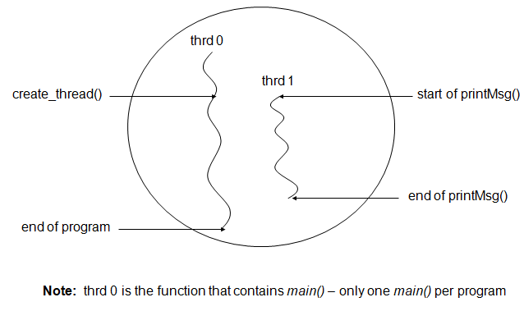
Example

Slide 20
Exiting Threads
  pthreads exist in user space and are seen by the kernel as a single process
    if one issues and exit() system call, all the threads are terminated by the OS
    if the main() function exits, all of the other threads are terminated
  To have a thread exit, use pthread_exit()
  Prototype:
    void pthread_exit(void *status);
    status: the exit status of the thread – passed to the status variable in the pthread_join() function of a thread waiting for this one

Slide 21
Example
    #include <stdio.h>
    #include <pthread.h>
    void printMsg(char* msg) {
    int status = 0;
    printf(“%s\n”, msg);
    pthread_exit(&status);
    }
    int main(int argc, char** argv) {
    pthread_t thrdID;
    int* status = (int*)malloc(sizeof(int));
    printf(“creating a new thread\n”);
    pthread_create(&thrdID, NULL, (void*)printMsg, argv[1]);
    printf(“created thread %d\n”. thrdID);
    pthread_join(thrdID, &status);
    printf(“Thread %d exited with status %d\n”, thrdID, *status);
    return 0;
    }

Slide 22
Synchronizing Threads
  Three basic synchronization primitives
    mutex locks
    condition variables
    Semaphores

Slide 23
Revision
What is thread
Benefits of Thread
Thread Types
Thread Programming

